Slide 1

PDF Accessibility – Best Practices for Authoring
Pete DeVasto
Greg Pisocky
Adobe Systems
CSUN 2010 WEB-1063
Friday, March 26, 2010
Notes:
Introduction
Today our topic is about achieving results in PDF files that make them accessible to individuals with disabilities. We’ll be using Adobe Acrobat 8 to enhance PDF files in order to make them accessible.

Slide 2
Agenda
Accessible Features of the File Format
Accessible Features of the File Format Viewer
Acrobat / Reader
Accessible Authoring Workflow
Microsoft Word / OpenOffice Writer
Adobe InDesign
Adobe LiveCycle Designer
Finishing Touches
Using Acrobat Professional
Checking the Results

Slide 3
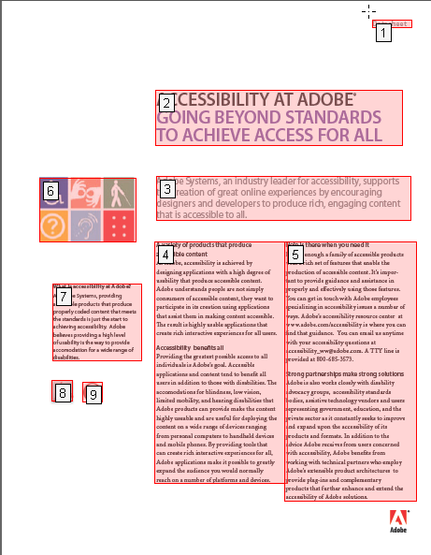
The File Format: Accessibility Requirements
Reading Order
Logical Reading Order and Tab Order – Does it make sense when you listen to it?
Elements
Expressed as Tags - <H1>, <H2>, <p>, etc.
Attributes
Alternate Text Descriptions for Non-Text Elements – Descriptions for tags and form fields
Language IDs – Specify the Document’s primary language. Specify alternate languages used in the docuement
Notes:
Any file format, including PDF has to be able to be structured in such a way that the content can be conveyed in a meaningful way.
For PDF, as with other formats, this means that you need to be able to establish a logical reading order – in other words, establish a text flow that makes sense when listening to it. For PDF forms this means establishing a logical tab order for navigating through the form’s fields in a sensible manner.
The other strucutural mechanism a file format has to support as an accomodation to individuals with limited or no vision is a means for providing alternate text descriptions for non text elements such as graphics and illustrations that are part of the content.
For PDF this means an ability to add ALT text for graphics and images. For the PDF form, the short description performs this function for form fields.
For PDF’s meant to be used as interactive forms, the equivalents to read order and alternate text description are called tab order and short description. Setting the tab order allows a user to navigate in a logical way using the tab key to move from one field in a form to the next in a logical manner. First name, last name, street address for example rather than first name, street address, last name.
The short description attaches a label to the form field that conveys the meaning of the lable to assistive technologies. This allows blind users to know they are in the field asking for their first name or have landed in the check box indicating gender.
Adobe has also introduced a tool exclusively dedicated to the creation of interactive PDF forms. The tool is the Adobe LiveCycle Designer. In addition to a rich set of features which make for compelling interactive online forms, the Adobe Designer includes tools for adding features to these forms which provide accessibility.

Slide 4
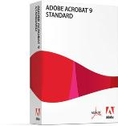
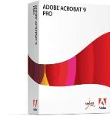
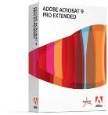


Viewer Features: Lowering Barriers to Accessibility
Works in Conjunction with Conventional Assistive Technology
Screen Readers:
Windows: IBM Home Page Reader, JAWS, SuperNova (Reader / Magnifier), Window-Eyes
Linux: Orca
Mac OS: VoiceOver
Voice Recognition: Dragon NaturallySpeaking (Windows)
Screen Magnifiers: Lunar, ZoomText (Windows)
Built-in Features in Adobe Reader 9 and all versions of Adobe Acrobat 9 Mean There is Accessibility without Additional Software
Incorporates Operating System Accessibility Features
Read Out Loud, Reflow, High Contrast View, Autoscroll, Accessibility Setup Assistant
Notes:
There are built in accessibility features in Adobe Acrobat and Adobe Reader which do not require the use of additional third party software products. Acrobat and Reader are designed to incorporate the accessibility features that are available from the operating system or are specific functions of Acrobat or Reader. Examples include the text to speech facility of read out loud, the reflow function that displays content in large type without losing the edges, high contrast settings for certain visual disabilities, and autoscroll for limited moblility. There is also a configuration wizard which allows users to configure Acrobat or Reader in a way that optimizes their use with accessibility preferences or with 3rd party assistive technology.
Conventional assistive technology products are 3rd party applications that individuals with disabilities rely upon to aid them in using computers effeciently. Acrobat and Reader work with popular screen readers on a variety of platforms, including JAWS, Window Eyes, and SuperNova. Other popular products that Acrobat and Reader work with are the Dragon Naturally Speaking Voice Recognition application and the Lunar and Zoomtext screen magnifiers to name a few.

Slide 5
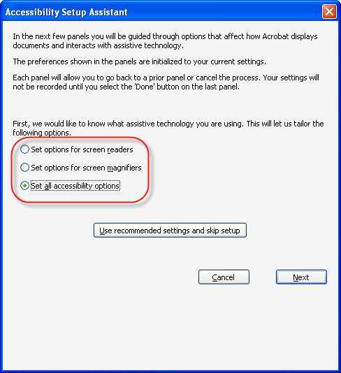
Viewer Feature: Optimize Adobe Acrobat / Adobe Reader for Best Results
Accessibility Setup Assistant Configures the User Agent for Optimal Performance with Assistive Technology
Adobe Acrobat Advanced > Accessibility> Setup Assistant
Adobe Reader Help>Accessibility Setup Assistant
Notes:
Accessibility settings are scattered about the Acrobat and Adobe Reader interface. This may pose a challenge to someone using assistive technology, so Adobe provides an Accessibility Setup Assistant which uses a wizard to assist users in configuring their copy of Acrobat or Adobe Reader in a way that works best with the assistive technology they are using.

Slide 6
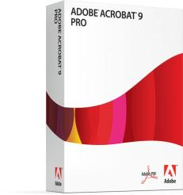

Adobe Acrobat Pro Versions Additional Accessibility Support
Compatible with Conventional Assistive Technology
Has Built in Accessibility Accommodations
Read Out Loud
High Contrast
Reflow
Autoscroll
Accessibililty Setup Assistant

Slide 7
Adobe Acrobat Pro Versions Additional Accessibility Support
Compatible with Conventional Assistive Technology
Has Built in Accessibility Accommodations
Read Out Loud
High Contrast
Reflow
Autoscroll
Accessibililty Setup Assistant
Facilitates Accessible Authoring
OCR
Add Tags
Touch Up Read Order Tool
Accessibility Checker

Slide 8
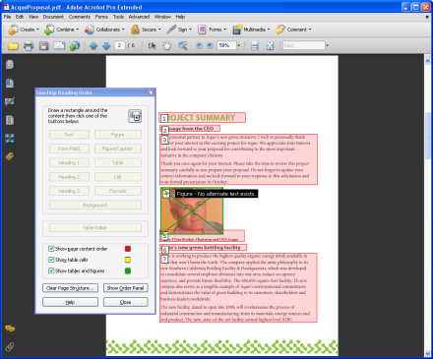
Product Feature: Acrobat TouchUp Read Order Tool
TouchUp Reading Order Tool in Acrobat 9 Professional for PDF Accessibility Repair
Review and correct reading order
Review and correct basic tagging issues
Add Alternate Text to Figures
Add Short Descriptions to Form Fields
Tag simple tables quickly and easily
Benefits
Quick and easy to detect tagging errors
Easy to fix most common errors
Notes:
The Touch Up Reading Order tool makes creating accessible PDFs less of a chore.
It makes it easier to perform critical accessibility functions such as reviewing and correcting read order, reviewing and correcting the tagging of figures, adding alternative text descriptions to non text elements in PDF files, and facilitates the tagging of simple tables quickly and easily.
The benefits of the touch up read order tool are summed up in ease of use. The Touch Up Reading Order tool makes it quick and easy to detect and repair tagging errors and the touch up read order tool makes it easy for users to fix the most common errors.

Slide 9

Accessible Authoring Workflow for PDF
You are now ready to Create an ACCESSIBLE PDF File
Applications that Create Tagged PDF
PDF Maker (for Microsoft Office) – Windows Only)
PDF Maker Plug-In for Internet Explorer
OpenOffice Writer
Adobe InDesign
Adobe FrameMaker
PDF Forms
LiveCycle Designer (Application Distributed with Acrobat 9 Pro)
Finishing Touches
Adobe Acrobat 9 Pro to Validate and Fix Problems
Notes:
When it comes to PDF accessibility there are only two scenarios you will encounter. You either have a PDF or you intend to create one.
If you have a previously created PDF file, you have to know something about its orignation and purpose. Did it come from a scan or an application? Is it meant to be a form? Does the PDF represent a document created in a desktop publishing or word processing appliction? Knowing the answers to these questions will guide you in determining what has to be done to the PDF file in order to make it accessible.
If you are creating a PDF file, you should attempt to use applications that can generate tagged PDF documents and forms.

Slide 10
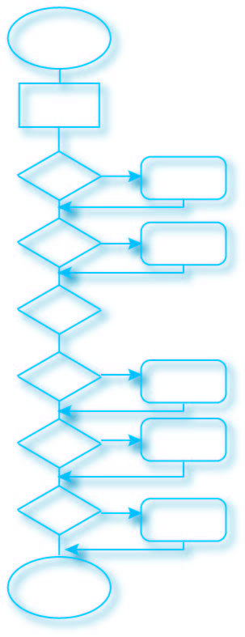
The PDF Accessible Authoring Workflow: Common Themes
Use Styles
Not Character Formats
Establish the Read Order
Way the Application Asks You To
Use Table Editing Tools
Not Spacing
Add Alternative Descriptions Using the Tool if You Can
Do it whenever you add a figure
Configure the Application
Check the right options
Now that it’s a PDF – Check the Results
Adobe Acrobat Pro / Netcentric Commonlook
Notes:
The next series of slides introduces and efficient workflow for producing accessible PDF files when using Adobe Acrobat Profession.
By asking yourself a series of questions in a particular order, you can quickly determine the accessibility of any given PDF file, and implement the appropriate techniques for adding the proper accessibility features to the PDF document at the most appropriate stage in the workflow.
First, determine if the PDF has originated from a scanned image. If so, then you begin the process by conducting an Optical Character Recognition (OCR) operation on the file. Once that has taken place, you then proceed to the next step determining if the document is meant to be an interactive form. Of course, if the PDF file did not originate from a scan, you would proceed immediately to the form test.
Once more, based upon the answer to the question, “Is the PDF intended to be a form?” you either add interactive form fields of go to the next step, determining if the PDF file has been tagged. If not, tag it, if so, determine if it has been properly tagged.
At the very end, you can make use of the automated tools inside of Adobe Acrobat 8 Professional to make sure all of the accessibility issues have been identified and addressed. This is done by running the Accessibility Full check and following its recommendations until a clean report is indicated.

Slide 11
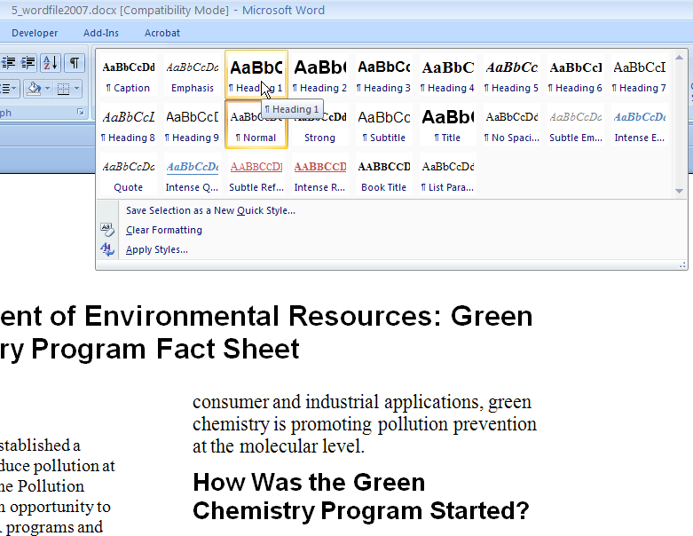
Use Styles
Do Not Use Character Formats
Notes:
If you are planning to convert a Microsoft Word document to PDF you should first add the accessibility features to the Microsoft Word document. This involves employing best practices for authoring in Word. Add alternative text to graphics in the Word document by double clicking the graphic to display the format picture dialog. The tab labelled “Web” in the format picture dialog is where users can add alternative text equivalents. For tables, use the Microsoft Word table editor, do not create the appearance of a table using tabs and spaces. Refrain from using character formats and instead use styles to achieve formatting effects.
The PDF Maker allows you to specify how Word elements will be translated into their PDF equivalents.
When ready, use the Convert to PDF command – Not the Print to Adobe PDF option. Convert to PDF invokes the PDF Maker and will result in a tagged PDF file once the conversion is complete.
As a last step, check the results in Acrobat 8 by running the Accessibility Full Check and following its recommendations for repair until No Errors are Detected.

Slide 12
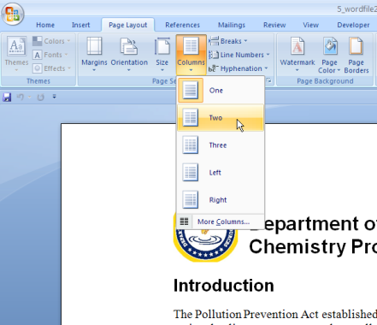
Establish the Read Order
Columns NOT Tables
Notes:
If you are planning to convert a Microsoft Word document to PDF you should first add the accessibility features to the Microsoft Word document. This involves employing best practices for authoring in Word. Add alternative text to graphics in the Word document by double clicking the graphic to display the format picture dialog. The tab labelled “Web” in the format picture dialog is where users can add alternative text equivalents. For tables, use the Microsoft Word table editor, do not create the appearance of a table using tabs and spaces. Refrain from using character formats and instead use styles to achieve formatting effects.
The PDF Maker allows you to specify how Word elements will be translated into their PDF equivalents.
When ready, use the Convert to PDF command – Not the Print to Adobe PDF option. Convert to PDF invokes the PDF Maker and will result in a tagged PDF file once the conversion is complete.
As a last step, check the results in Acrobat 8 by running the Accessibility Full Check and following its recommendations for repair until No Errors are Detected.

Slide 13
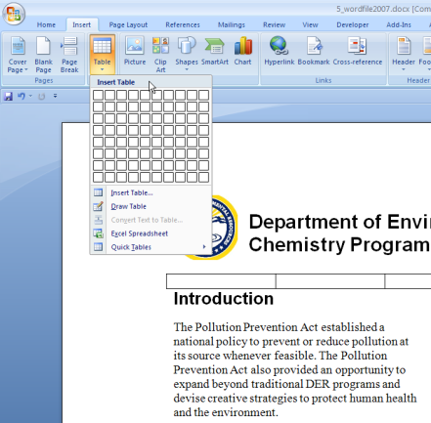
Use Table Editing Tools
Create a Table don’t Use Tabs
Notes:
If you are planning to convert a Microsoft Word document to PDF you should first add the accessibility features to the Microsoft Word document. This involves employing best practices for authoring in Word. Add alternative text to graphics in the Word document by double clicking the graphic to display the format picture dialog. The tab labelled “Web” in the format picture dialog is where users can add alternative text equivalents. For tables, use the Microsoft Word table editor, do not create the appearance of a table using tabs and spaces. Refrain from using character formats and instead use styles to achieve formatting effects.
The PDF Maker allows you to specify how Word elements will be translated into their PDF equivalents.
When ready, use the Convert to PDF command – Not the Print to Adobe PDF option. Convert to PDF invokes the PDF Maker and will result in a tagged PDF file once the conversion is complete.
As a last step, check the results in Acrobat 8 by running the Accessibility Full Check and following its recommendations for repair until No Errors are Detected.

Slide 14
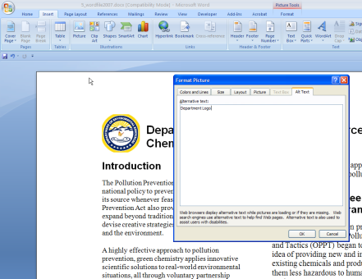
Add Alternative Text Descriptions
People Often Forget this Step
Notes:
If you are planning to convert a Microsoft Word document to PDF you should first add the accessibility features to the Microsoft Word document. This involves employing best practices for authoring in Word. Add alternative text to graphics in the Word document by double clicking the graphic to display the format picture dialog. The tab labelled “Web” in the format picture dialog is where users can add alternative text equivalents. For tables, use the Microsoft Word table editor, do not create the appearance of a table using tabs and spaces. Refrain from using character formats and instead use styles to achieve formatting effects.
The PDF Maker allows you to specify how Word elements will be translated into their PDF equivalents.
When ready, use the Convert to PDF command – Not the Print to Adobe PDF option. Convert to PDF invokes the PDF Maker and will result in a tagged PDF file once the conversion is complete.
As a last step, check the results in Acrobat 8 by running the Accessibility Full Check and following its recommendations for repair until No Errors are Detected.

Slide 15
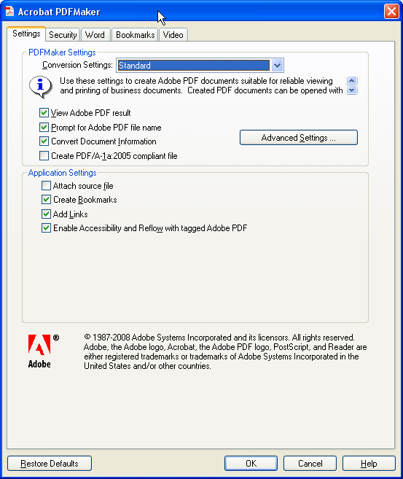
Configure the Application
Add Alternative Text to Graphics in the Word File
Select an image, use Format Picture dialog, add ALT text using the Web tab
Do NOT Use Spaces, Tabs to create tables, use the Table Editor
Do NOT Use Character formatting for Headings, Use Styles
Set Your Preferences
From the Microsoft Word Menu: Adobe PDF > Change Conversion Settings
ALT + B + S
Make sure “Enable Accessibility and Reflow with Tagged PDF” option is selected
Convert with Adobe PDFMaker
From the Microsoft Word Menu: Adobe PDF > Convert to Adobe PDF
ALT + B + C
Select the icon
Check the Results in Adobe Acrobat 8
Advanced > Accessibility > Full Check
Alt + A + A + F
Follow the Suggestions for Repair, Repeat Until No Errors Detected
Notes:
If you are planning to convert a Microsoft Word document to PDF you should first add the accessibility features to the Microsoft Word document. This involves employing best practices for authoring in Word. Add alternative text to graphics in the Word document by double clicking the graphic to display the format picture dialog. The tab labelled “Web” in the format picture dialog is where users can add alternative text equivalents. For tables, use the Microsoft Word table editor, do not create the appearance of a table using tabs and spaces. Refrain from using character formats and instead use styles to achieve formatting effects.
The PDF Maker allows you to specify how Word elements will be translated into their PDF equivalents.
When ready, use the Convert to PDF command – Not the Print to Adobe PDF option. Convert to PDF invokes the PDF Maker and will result in a tagged PDF file once the conversion is complete.
As a last step, check the results in Acrobat 8 by running the Accessibility Full Check and following its recommendations for repair until No Errors are Detected.

Slide 16
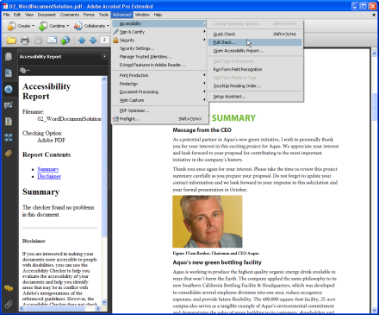
Check the Newborn PDF - Make Sure You Have Not Missed Anything
Run the Accessibility Full Check
Menu: Advanced > Accessibility > Full Check
ALT + A + A + F
Make recommended and appropriate repairs –
Read the Report, Follow the Hyperlinks
Repeat this process until “No Problems Found”
Notes:
As a last step, the accessibility full check provides an automated means for identifying any accessibility issues that remain. The accessibility full check also generates an accessibility report which provides links to the problem areas within the document. In addition, the accessibility report offers hints for repairing the various problems it identifies in a PDF document.
Run the accessibility full check and follow its recommendations until the checker indicates there are no accessibility problems in the document. At this point, you are done.

Slide 17

Loose Ends (Some Common Errors That Crop Up)
Check the Language Attribute in Acrobat
File > Properties (Ctrl D)
Choose the Advanced Tab, Select the Appropriate Language
Use Tags Panel to Provide Table Headers <TH> in First Table Row
In LiveCycle Designer, First Page Subform Needs to Have a Language Set
Fix Tab Order Does Not Correspond with Read Order Error
Display the Pages Panel: View > Navigation Panel > Pages
Select a Page and then Select All (Ctrl + A)
Select Page Properties and Check “Use Document Structure”

Slide 18

A Caution Regarding Automated Checking
There is NO Accessibility Button
Tell Your Customers Accessibility Requires Human Testing in addition to Automated Checking
Checking Can Only Detect for the Presence or Lack of Required Items
Cannot Check if an Item is Correct or Appropriate
Accessibility is a New Item for the Production Workflow – Like Authoring, Layout, Proofreading, etc.
Note Also, Publishers Will Need to Employ a Variety of Techniques and Methods

Slide 19
For More Information
Adobe’s Accessibility Website: Your Resource for Accessibility Information for Adobe Products
www.adobe.com/accessibility
Adobe’s Acrobat Accessibility Guides
http://www.adobe.com/accessibility/products/acrobat/training.html
Adobe’s Voluntary Product Accessibility Templates (VPATs)
http://www.adobe.com/resources/accessibility/tools/vpat/
Notes:
A number of resources are at your disposal to learn more about the accessibility of Adobe Acrobat and all of the Adobe product line.
The website is located at www.adobe.com/accessibility and can also be accessed from the accessibility link appearing on Adobe’s home page at www.adobe.com. Additionally, Voluntary Product Accessibility Templates or VPATs (pronounced VEE PAT) are available at Adobe’s Accessibility Resource Center. The VPAT is a document that describes how a particular electronic and information technology product satisfies the requirements of the US Government’s Section 508 Law.

Slide 20

Notes:
Thank You

Slide 21
声明：
所有的版权属于原有公司，文件均来自公开渠道
此文件仅供学习使用，任何人不得进行以此为商业目的的行为
如有疑问，请立即删除
学习世界五百强和咨询公司PPT课程请访问如下网站搜索：“司马懿”
百度传课：司马懿PPT学校
网易学堂：司马懿PPT学校
知乎： 司马懿PPT学校
访问地址
https://www.chuanke.com
访问地址
https://study.163.com
访问地址
https://www.zhiu.com

